Slide 1
Mobile Application Development
Lecture 16

Slide 2
What is NoSQL Database
NoSQL stands for “Not Only SQL”.
NoSQL database environment is a non relational, schema-less and largely distributed database.
Developed in late 2000s to deal with limitations of SQL databases, especially scalability, multi-structured data.
Notes:
First of all, we need to understand what Parent, Child, and Sibling components are.

Slide 3
NoSQL vs SQL Databases
NoSQL is free from joins and relationships.
No Entity Relationship Diagrams (ERD).
RDBMS (Relational Database Management Systems) use expensive joins.
Joins slower the speed of queries.
Notes:
First of all, we need to understand what Parent, Child, and Sibling components are.

Slide 4
NoSQL vs SQL Databases
NoSQL has a much lower maintenance cost compared to RDBMS.
Structure and data types are fixed in advance in RDBMS. To store information about a new data item, the entire database must be altered.
Notes:
First of all, we need to understand what Parent, Child, and Sibling components are.

Slide 5
List of SQL and NoSQL Databases
SQL
MySQL, MariaDB, Postgresql, Oracle Database, MS SQL, AmazonRDS
NoSQL
MongoDB, Redis, CouchDB, Cloudant, Cassandra, Neo4j, ArangoDB, OrientDB, DynamoDB, FireStore, Firebase Real-time
Notes:
First of all, we need to understand what Parent, Child, and Sibling components are.

Slide 6
Scaling Databases
Scaling Databases mean increasing the size of database once the storage requirement increases.
There are 2 ways.
1. Add additional Servers (Horizontal Scaling).
2. Increase the size of existing server (Vertical Scaling).
Notes:
First of all, we need to understand what Parent, Child, and Sibling components are.

Slide 7
Scaling Databases
Vertical Scaling (SQL) We keep increasing RAM, Storage capacities of the single server. This becomes very expensive as it grows. 1 large server is more costly than 3,4 small servers. Scaling vertically meaning a single server must be made increasingly powerful in order to deal with increased demand.
Notes:
First of all, we need to understand what Parent, Child, and Sibling components are.

Slide 8
Scaling Databases
Horizontal Scaling (NOSQL)
Horizontal scaling means to add more commodity servers or cloud instances.
The solution to support rapidly growing applications is to scale horizontally, by adding servers instead of concentrating more capacity in a single server.
Notes:
First of all, we need to understand what Parent, Child, and Sibling components are.

Slide 9
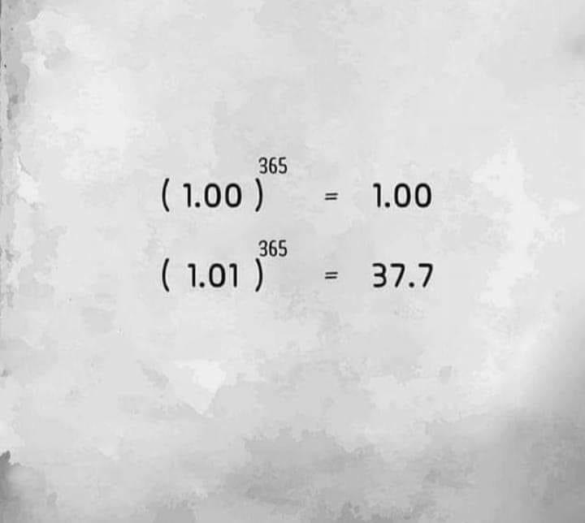

Slide 10
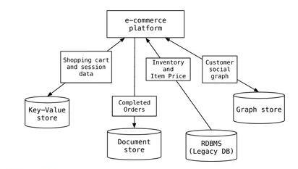
Why NoSQL ?
Scaling is easier and less costly.
PolyGlot Persistance
Polyglot Persistence means that when storing data, it is best to use multiple data storage technologies, chosen based upon the way data is being used
Notes:
First of all, we need to understand what Parent, Child, and Sibling components are.

Slide 11
Why NoSQL ?
Ensuring global availability is difficult for relational databases where separate add-ons are required – which increases complexity.
mobile games can reach tens of millions of users in a matter of months e.g. Pokemon GO, Clash of Clans etc
With a distributed, scale-out database, mobile applications can start with a small deployment and expand as the user base grows, rather than deploying an expensive, large relational database server from the beginning.
Notes:
First of all, we need to understand what Parent, Child, and Sibling components are.

Slide 12
Why NoSQL ?
Analytics and Business Intelligence (Big Data). Cassandra etc
Caching
A number of products provide a caching tier for SQL database systems. any NoSQL database technologies have excellent integrated caching capabilities. Caching means we store some data we frequently need in a small cache and retrieve from that instead of directly from Database. Redis.
Notes:
First of all, we need to understand what Parent, Child, and Sibling components are.

Slide 13
Types of NoSQL Databases
Document Store (MongoDB, FireStore, CouchDB etc).
Key Value (Redis, Amazon DynamoDB, Local Storage, Riak, Firebase Realtime).
Graph Database (Neo4j, Giraph)
Column Oriented (Cassandra, Hbase)
Notes:
First of all, we need to understand what Parent, Child, and Sibling components are.

Slide 14
Link to resources
http://slides.com/alamgirqazi/nosql
https://github.com/alamgirqazi/IntroToNoSQL (in detail)
Notes:
First of all, we need to understand what Parent, Child, and Sibling components are.

